Slide 1

Topic: Fractions
EQ: How are mixed numbers and improper fractions related?

Slide 2
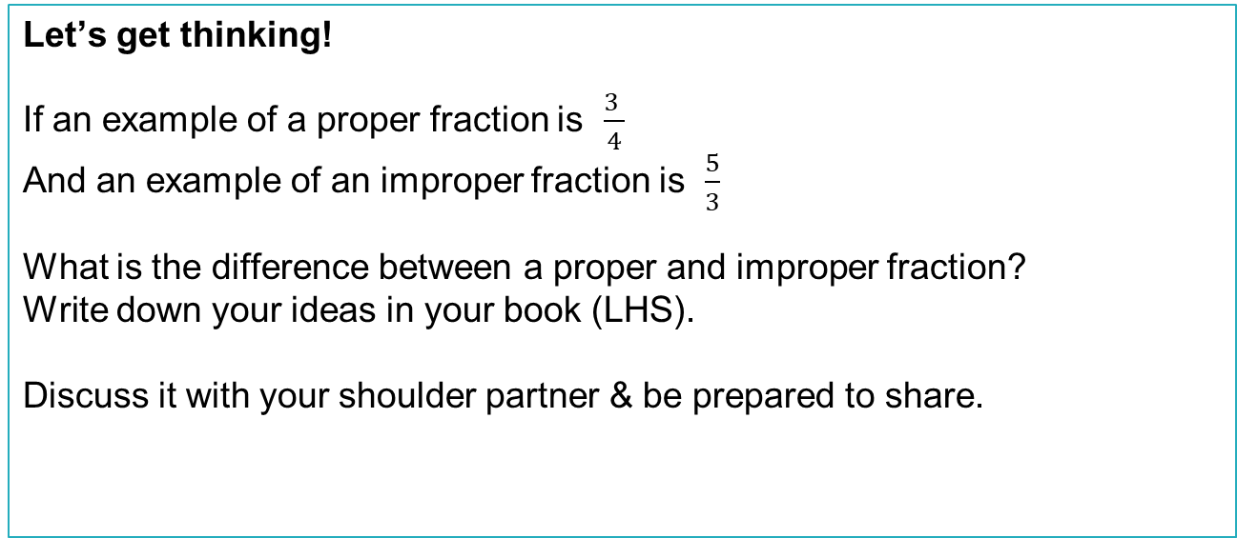
24
7
30
Topic: Fractions
Date
EQ: How are mixed numbers and improper fractions related?
Let’s get thinking!
If an example of a proper fraction is $\frac{3 }{4}$
And an example of an improper fraction is $\frac{5}{3}$
What is the difference between a proper and improper fraction?
Write down your ideas in your book (LHS).
Discuss it with your shoulder partner & be prepared to share.

Slide 3


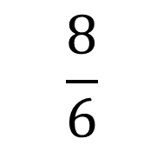
24
7
30
Topic: Fractions
Date
EQ: How are mixed numbers and improper fractions related?
What is the difference between a proper and improper fraction?
An improper fraction has a value greater than 1
The numerator is larger than the denominator
What does this fraction look like?
$$\frac{8}{6}$$
The denominator of 6 means the whole is divided into 6 equal parts.
The numerator of 8 means that we have 8 pieces, which is 6 parts of one whole and 2 parts of another.
What is another way we could write this fraction?
Notes:
Mixed number on next slide

Slide 4
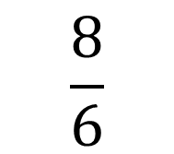
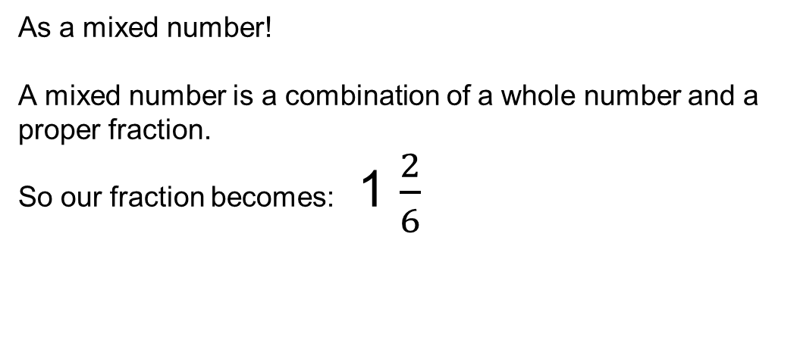
24
7
30
Topic: Fractions
Date
EQ: How are mixed numbers and improper fractions related?
What is another way this fraction can be written?
$$\frac{8}{6}$$
As a mixed number!
A mixed number is a combination of a whole number and a proper fraction.
So our fraction becomes: 1 $\frac{2}{6}$
Notes:
Do another 1 or 2 examples on the board if needed for your class

Slide 5
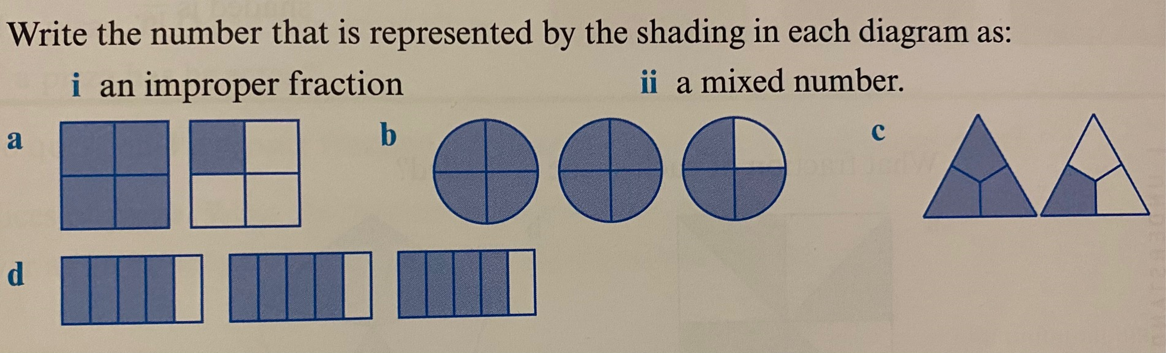
24
7
30
Topic: Fractions
Date
EQ: How are mixed numbers and improper fractions related?
Notes:
Have students do this LHS of book and go through

Slide 6
24
7
30
Topic: Fractions
Date
EQ: How are mixed and improper fractions related?
0
5
Notes:
Post it notes:
Give students fractions to put on the number line, proper, improper and mixed
Using the same denominator
Vary task difficulty based on your students

Slide 7


Slide 8
24
7
30
Topic: Fractions
Date
EQ: How are mixed numbers and improper fractions related?
Complete the worksheet
Write your summary for the lesson in your book.
.

